Slide 1


Mapping Hemochromatosis Genes using a Novel Recessive Diplotype Approach in the Marshfield Clinic Personalized Medicine Research Project (PMRP)
Shicheng Guo
Center for Precision Medicine Research
Marshfield Clinic Research Institute
03/13/2019

Slide 2
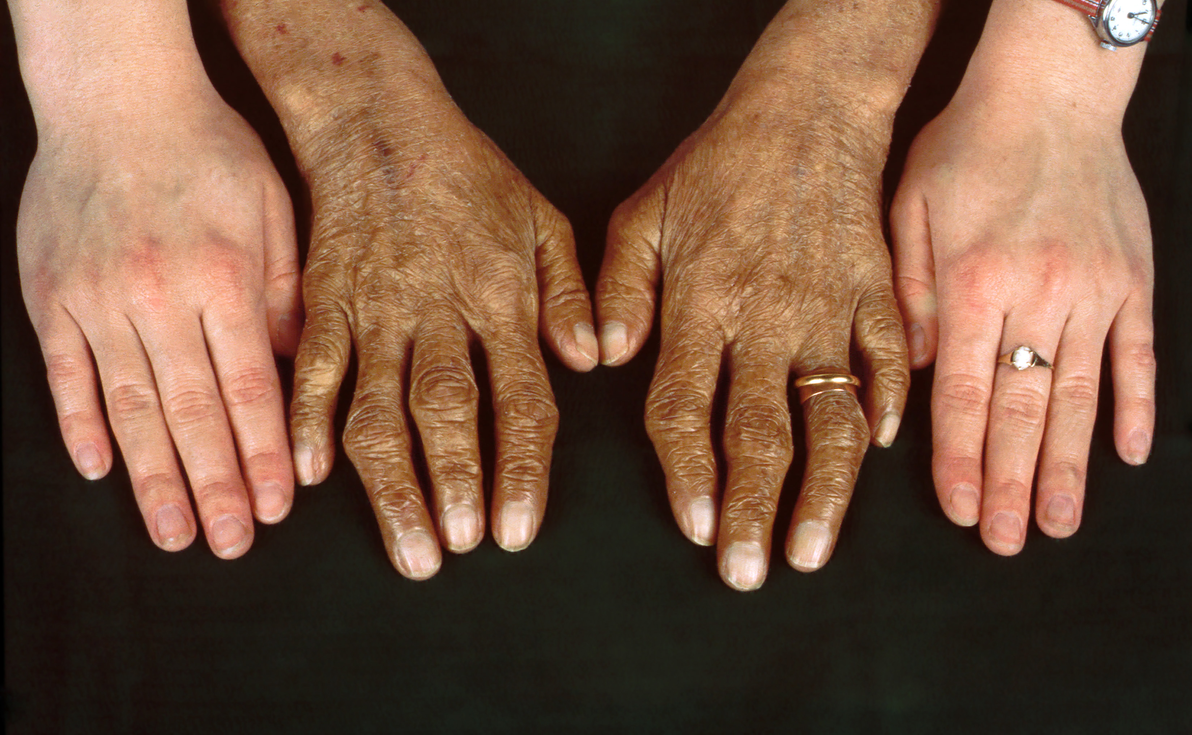
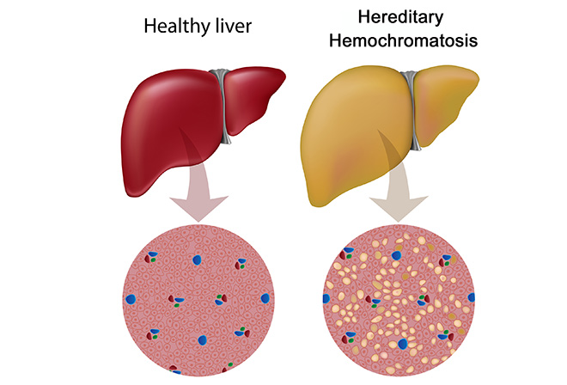
Hemochromatosis: clinical symptoms
Hereditary hemochromatosis (HH) is a genetic disorder characterized by excessive iron accumulation that results in multiple tissues damage
Skin bronzing or hyperpigmentation (70%)
Liver disease (hepatomegaly, 13%; cirrhosis, 13%)
Diabetes mellitus (48%)
Arthropathy
Amenorrhea, impotence, hypogonadism
Grey’s Anatomy: https://www.youtube.com/watch?v=H4SAK7vgfUo
Notes:
Hereditary hemochromatosis is a genetic disorder characterized by excessive iron (Fe) accumulation that results in tissue damage. Manifestations can include systemic symptoms, liver disorders, cardiomyopathy, diabetes, erectile dysfunction, and arthropathy. Diagnosis is by elevated serum ferritin, iron, and transferrin saturation levels and confirmed by a gene assay. Treatment is usually with serial phlebotomies. The most common clinical symptoms are skin bronzing and liver diseases.

Slide 3
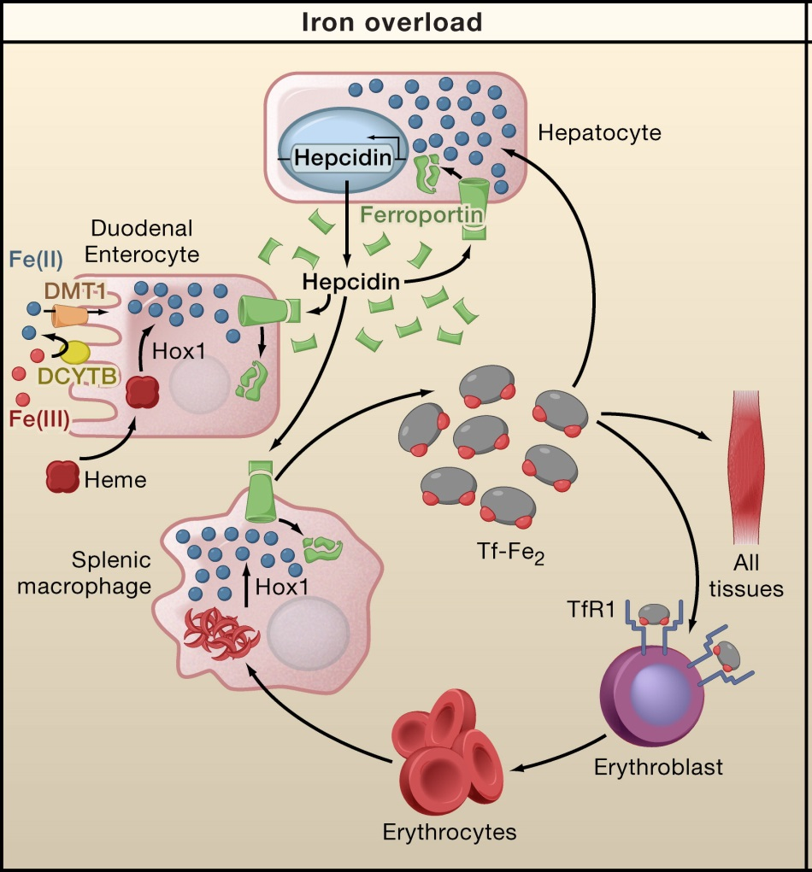
Human iron metabolism and iron homeostasis
Liver cells
Storage and Regulation
HAMP
Intestinal mucosal cells
Iron Absorption
SLC40A1
Blood Cells
Storage and Transport

Slide 4
Human iron metabolism and iron homeostasis
Liver cells
Storage and Regulation
HAMP
Intestinal mucosal cells
Iron Absorption
SLC40A1
Iron Absorption：DCYTB、DMT1
Iron Storage：Ferritin
Blood Cells
Storage and Transport
Notes:
铁离子代谢是一个非常复杂精细的过程，铁离子的摄入主要效应细胞是成熟的十二指肠上皮细胞，而外界铁离子的来源是食物中的铁。当食物中的铁离子到达十二指肠时，铁离子为三价铁(Fe³⁺)，Fe³⁺会在十二指肠色素B等还原酶的作用下还原成Fe²⁺，Fe²⁺在二价金属离子转运体DMT1作用下转运至上皮细胞内。1）如果机体不需要Fe²⁺，那么Fe²⁺会结合到铁蛋白(Ferritin)上，储存在细胞内部。铁蛋白是由24个亚基组成，组合成有一个大的中心空腔的球壳，蛋白质外壳上的气孔可使铁的进出，一个铁蛋白可以结合≤4500个铁离子。2）如果机体需要Fe²⁺那么Fe²⁺就会在铁转运蛋白(FPN1)作用下迅速转运到血浆内以供机体的利用。在血浆中，铁离子必须要与转铁蛋白结合（每个转铁蛋白结合≤2个铁离子），然后由机体利用。

Slide 5
Human iron metabolism and iron homeostasis
Liver cells
Storage and Regulation
HAMP
Intestinal mucosal cells
Iron Absorption
SLC40A1
Iron Transporter：Fpn1、TfR1
Iron Storage：Tf
Blood Cells
Storage and Transport
Notes:
主要利用铁的器官就是骨髓，心脏、骨骼肌和肝脏等也会少量的利用铁。骨髓中早幼粒红细胞会在铁的作用下合成血红蛋白，进行正常的氧气运输功能。而血红细胞在生命周期结束后会由巨噬细胞吞噬，释放出铁离子，进行进一步循环利用。

Slide 6
Human iron metabolism and iron homeostasis
Liver cells
Storage and Regulation
HAMP
Iron homeostasis：
hepcidin
Intestinal mucosal cells
Iron Absorption
SLC40A1
Blood Cells
Storage and Transport
Notes:
铁离子的内稳态主要是由铁调素(Hepcidin)来严格调控的，hepcidin主要是肝细胞分泌的，hepcidin的合成主要由铁离子含量调控，hepcidin与其配体FPN1结合，进一步引起FPN1的泛素化，构象改变以及降解。因此当机体缺铁时，hepcidin水平很低，就会促进小肠上皮细胞细胞内储存铁的释放，相反的，当机体铁过度时，hepcidin的合成增加，就会结合到FPN1上，抑制肠上皮细胞储存铁的释放。

Slide 7
Genetic etiology of hemochromatosis
 | Type 1 | Type 2A | Type 2B | Type 3 | Type 4
Name | Classic HHC | Juvenile HHC | Juvenile HHC | TfR2-related HHC | Ferroportin-related iron overload
Gene | HFE | HJV | HAMP | TfR2 | SLC40A1
Protein Produced | HFE | Hemojuvelin | Hepcidin | Transferrin receptor 2 | Ferroportin (iron regulatory protein)
Inheritance | autosomal recessive | autosomal recessive | autosomal recessive | autosomal recessive | autosomal dominant
Function | interruption of transferrin-bound iron, possible modulation of hepcidin regulation | unknown; possible hepcidin modulation | regulation of iron release in intestinal and blood cells | possible interference of iron uptake by liver cells | possible interference of iron export from intestinal, liver and placental cells
Organ Damage | variable | high | high | variable | low
Age of Onset | 40s or 50s | 20s or 30s | 20s or 30s | 40s or 50s | 40s or 50s

Slide 8
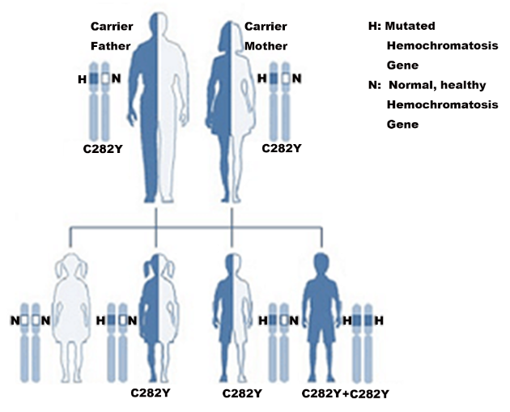
Hereditary hemochromatosis : Recessive Genetic Inheritance
HFE-hemochromatosis/HJV-hemochromatosis
If both parents are carriers of one C282Y mutation in HFE-hemochromatosis gene
25% HH affected, 50% carrier and 25% normal
If one of parents is affected and another one is C282Y mutation carrier.
50% HH affected, 50% carrier
If both parents are affected (both of them have 2 C282Y)
100% HH affected

Slide 9
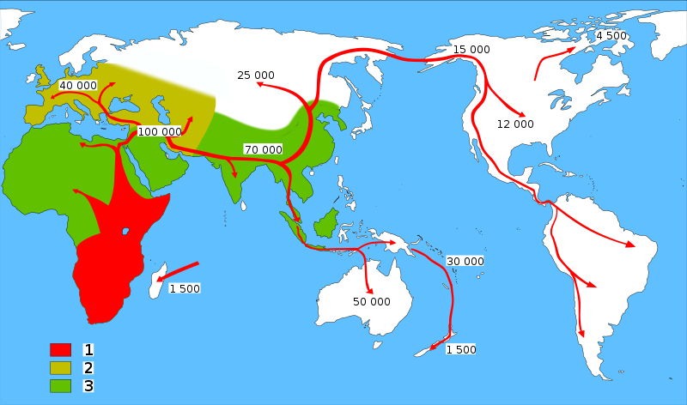
HFE-Hemochromatosis and Human migrations
Neolithic Agricultural Revolution
C282Y ~6000
HFE C282Y, ~6000 years ago
85–90%: Northern European Descent
60%: Mediterranean populations
0% in Asian population
The C282Y allele is the major cause of hemochromatosis as a result of excessive iron absorption. The mutation arose in continental Europe no earlier than 6,000 years ago, coinciding with the arrival of the Neolithic agricultural revolution.
Tsui WM, et al. The C282Y mutation of the HFE gene is not found in Chinese haemochromatotic patients: multicentre retrospective study. Hong Kong Med J 2000;6:153-158.

Slide 10
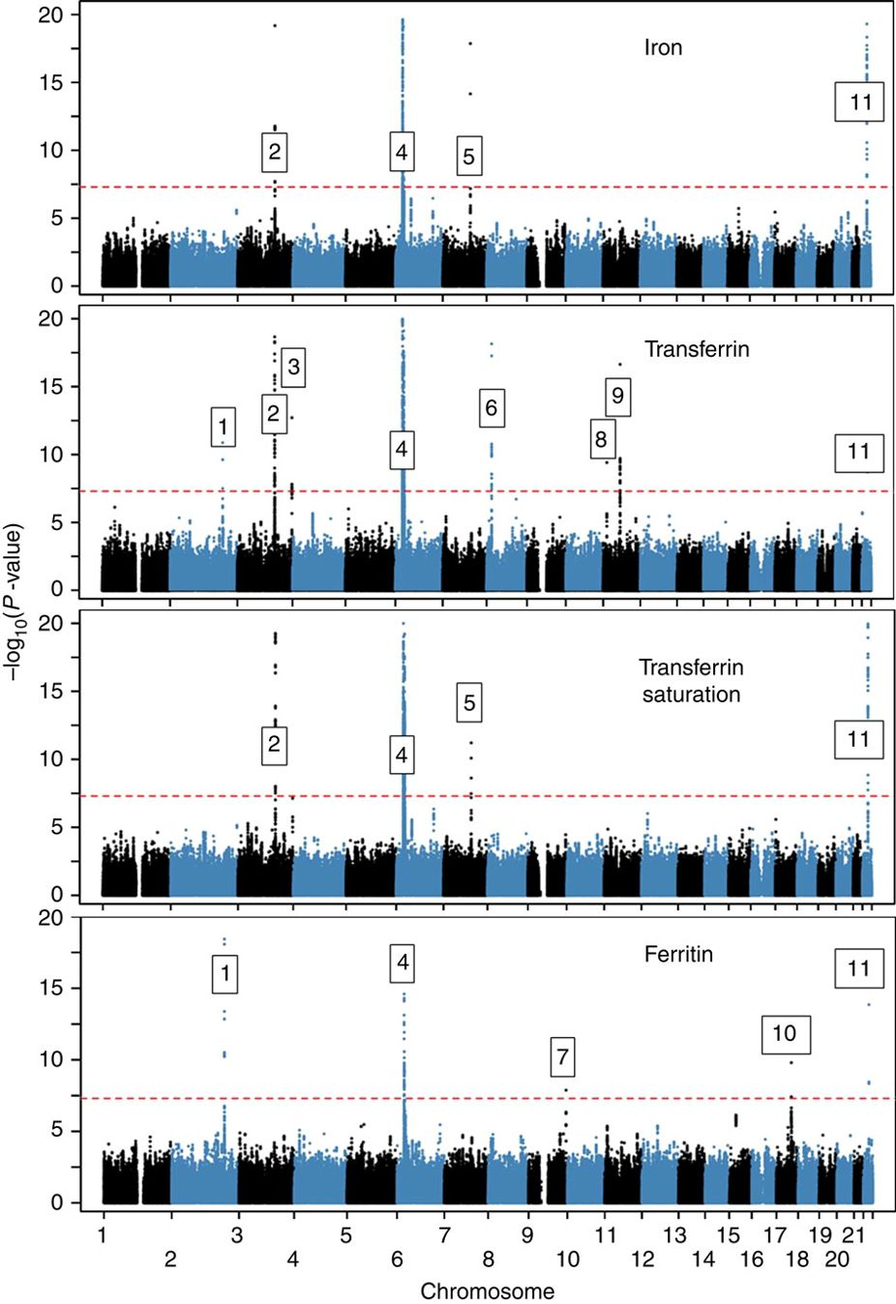
Novel loci affecting iron homeostasis and their effects in individuals at risk for hemochromatosis
HFE, HJV, HAMP, TFR2, SLC40A1
In 2014, Benyamin and colleagues: GWAS
Discovery: 23,986 samples
Validation: 24,986 samples
11 genome-wide-significant (P<5 × 10−8) loci, some including known iron-related genes (HFE, SLC40A1, TF, TFR2, TFRC, TMPRSS6) and others novel (ABO, ARNTL, FADS2, NAT2, TEX14).
Limitation: conventional statistic models
Benyamin B, Esko T, Ried JS, Radhakrishnan A, Vermeulen SH, Traglia M, Gogele M, et al. Novel loci affecting iron homeostasis and their effects in individuals at risk for hemochromatosis. Nat Commun 2014;5:4926.

Slide 11
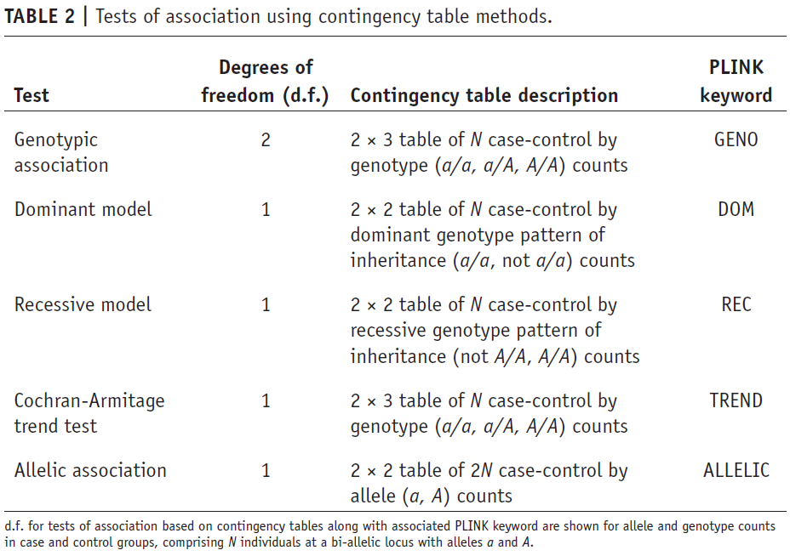
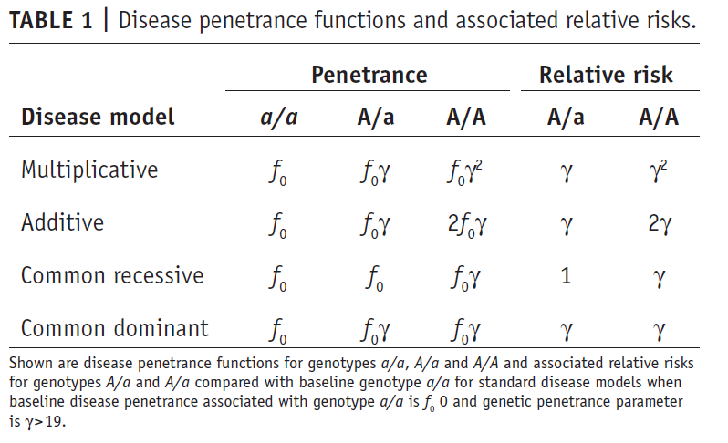
Disease penetrance functions, relative risks and association using contingency table methods
Notes:
As we know there are different disease models for the genetic variants: such as multiplicative, additive, recessive, dominant. Meanwhile, we have different statistic strategy to identify the associated variants for these different disease model.

Slide 12
Exome-wide, Gene-based Recessive Diplotype Scan
Single Site Recessive Effects
Recessive Diplotype
site by site
region by region
Gene-by-Gene Scanning to Identify Disease Genes

Slide 13
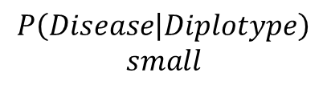
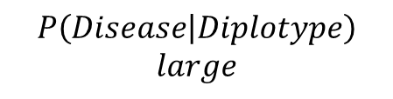
Recessive Diplotype Scan
Power calculations
2-locus model
Gene-based Monte Carlo
using 1000 Genomes
P₁₁
P₁₂
P₂₁
P₂₂
P₁₂ | P₁₂
P₁₁ | P₁₁
P₁₂ | P₂₁
P₁₁ | P₁₂
$$P\left(Disease | Diplotype\right)$$
$$small$$
P₁₂ | P₂₂
$$P\left(Disease | Diplotype\right)$$
$$large$$
P₁₁ | P₂₁
P₂₁ | P₂₁
P₁₁ | P₂₂
P₂₁ | P₂₂
P₂₂ | P₂₂

Slide 14
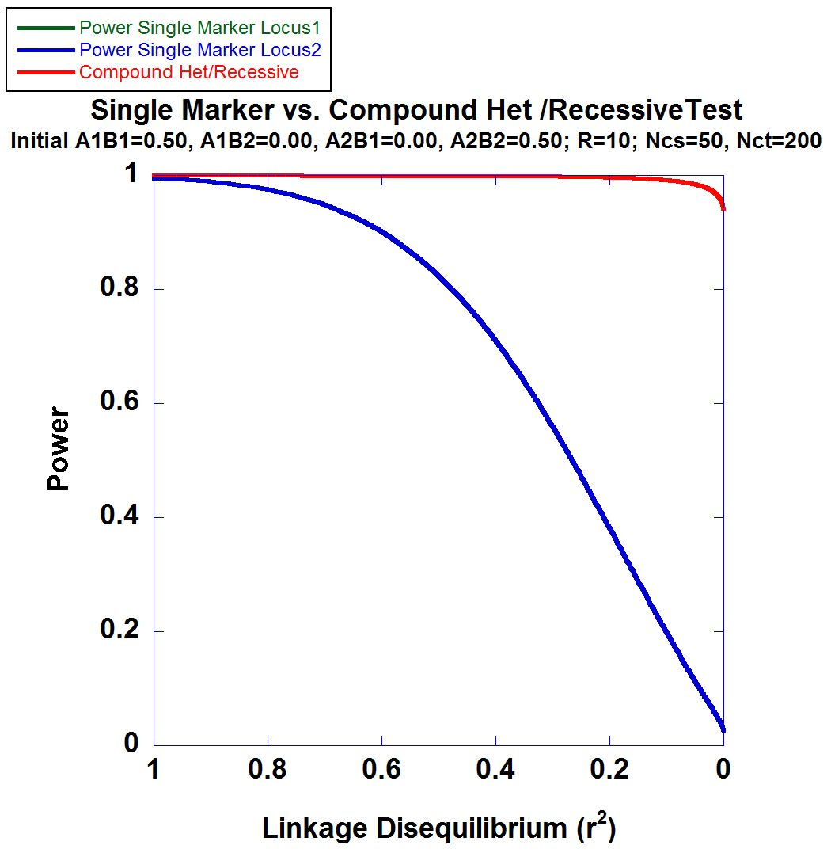
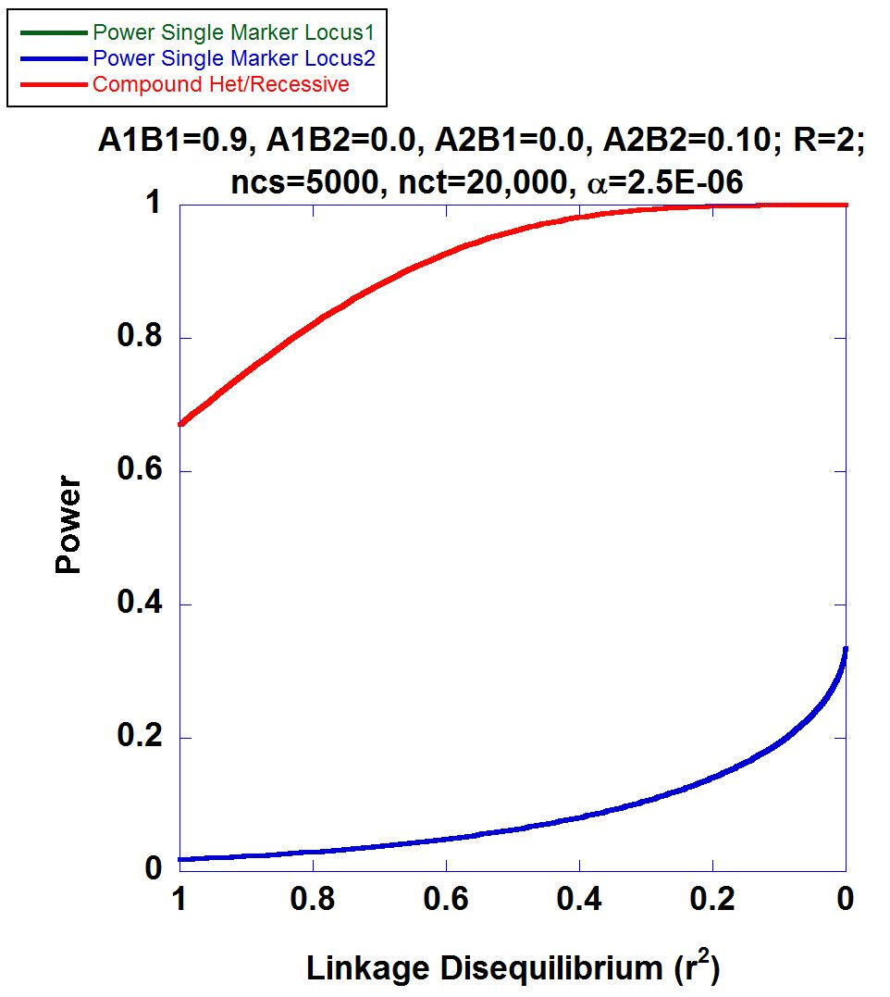
2-locus Power Calculations

Slide 15
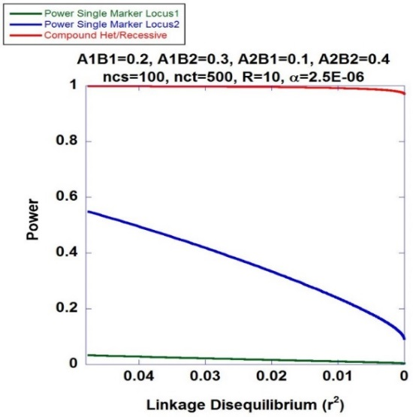
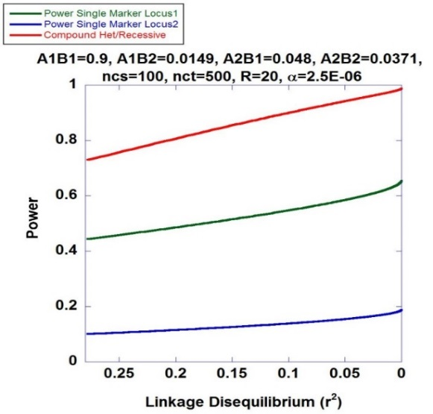
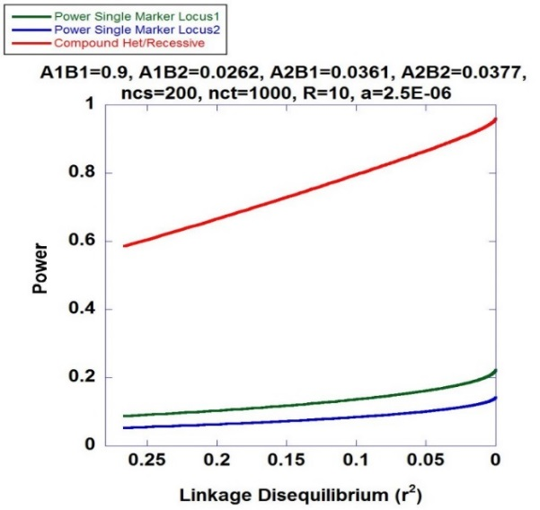
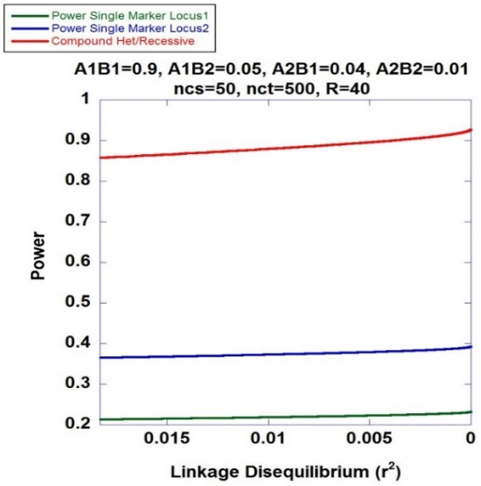
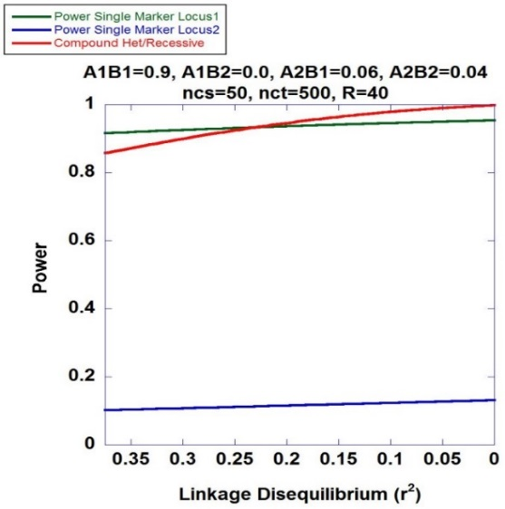
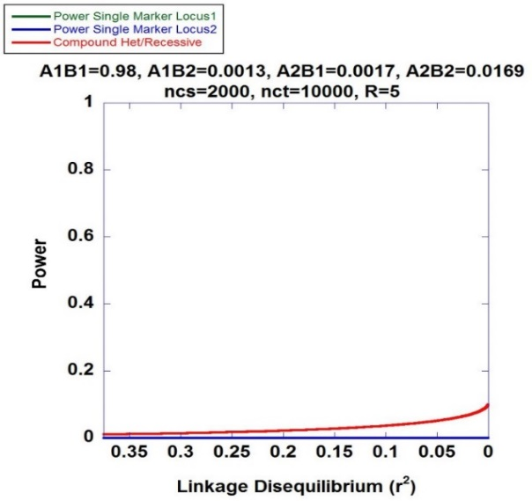
Higher Power of Recessive Diplotype Scan benefits PMRP
Recessive Diplotype approach always has higher power to identify the associated variants

Slide 16
Mapping Hemochromatosis Genes using a Novel Recessive Diplotype approach in PMRP
Exome beadchip data used on 10,000 subjects
PCA used to exclude genetic background outliers
Phasing using localized haplotype clustering
Putative functional variants: GWAS-significant, nonsynonymous, 3’UTR, 5’UTR, or splice site
Two or more in silico pathogenic annotations
ICD9: two or more instances of (i) iron metabolism disorder (ii) hereditary hemochromatosis, (iii) unspecified hemochromatosis
Transferrin saturation (ratio of serum iron to transferrin iron-binding capacity) > 48%
18 cases identified and 6,896 controls

Slide 17
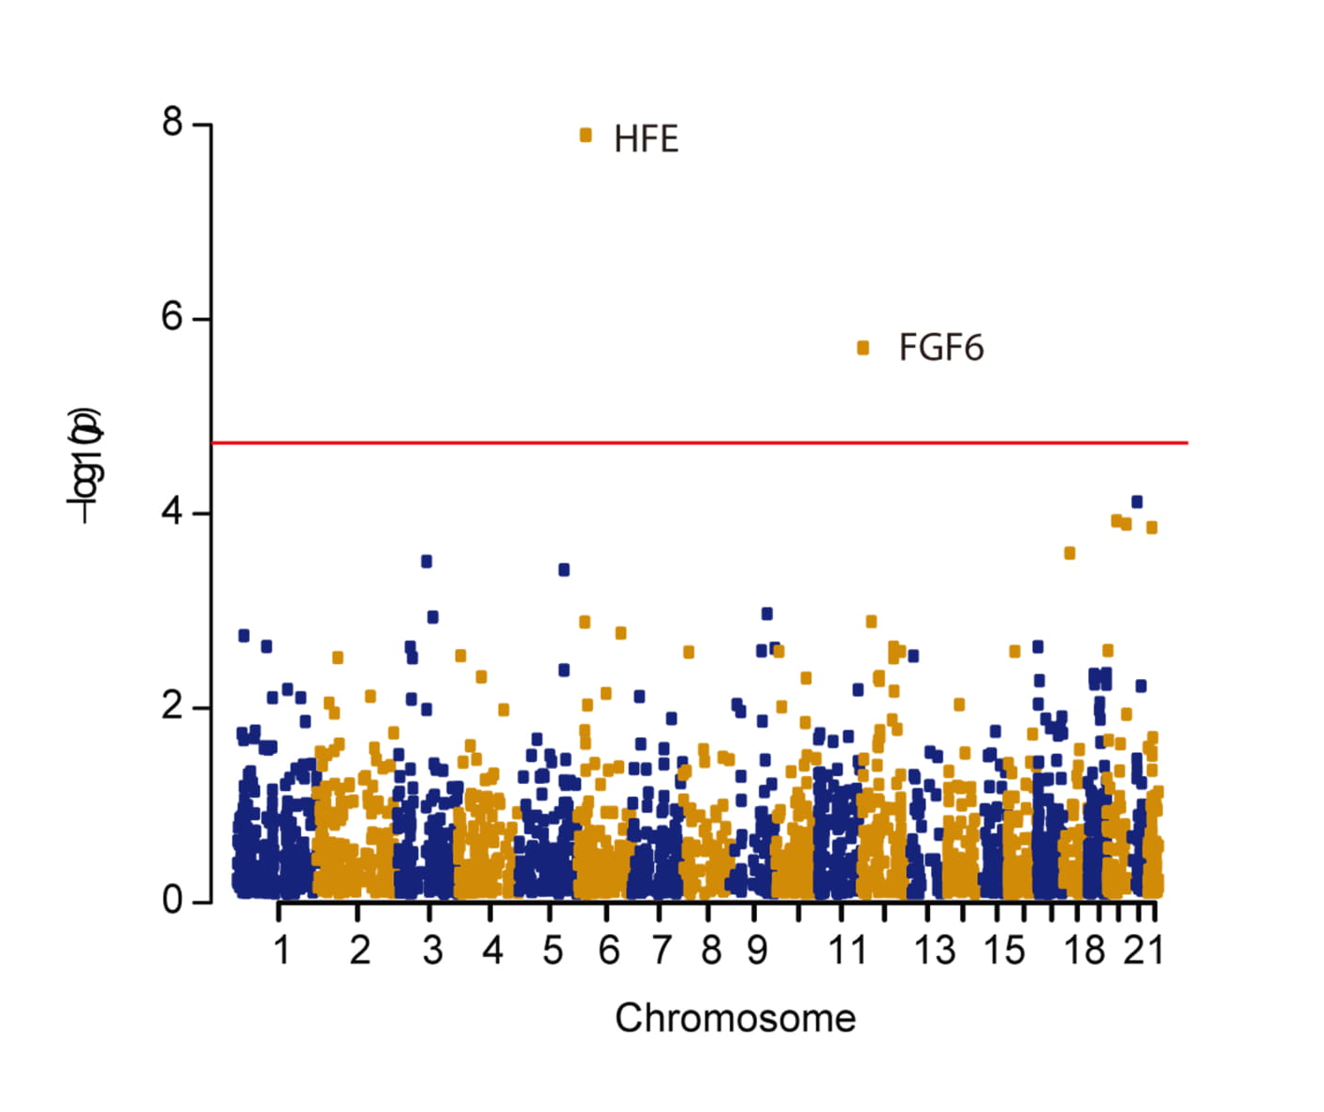
Manhattan Plot
CHR | GENE | P | OR#
chr6 | HFE | 1.29×10⁻⁸ | 28.6
chr12 | FGF6 | 1.99×10⁻⁶ | 22.8
chr21 | KRTAP15-1 | 7.55×10⁻⁵ | 6.78
chr20 | XKR7 | 1.18×10⁻⁴ | 43.6
chr20 | CABLES2 | 1.28×10⁻⁴ | 42.4
chr22 | THOC5 | 1.38×10⁻⁴ | 6.24

Slide 18
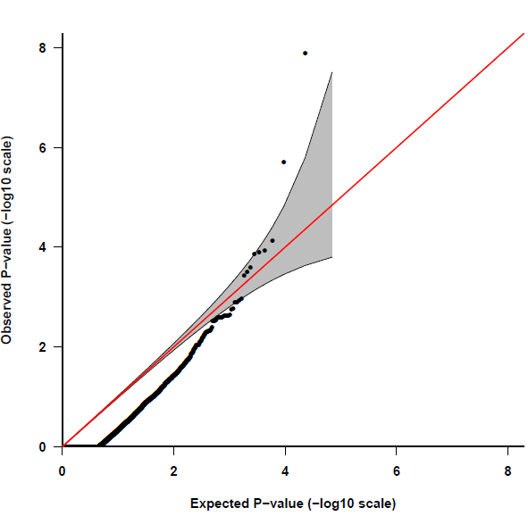
Quantile-Quantile Plot
HFE
FGF6
Fibroblast Growth Factor 6
Heparin-Binding Growth Factor 6
Heparin Secretory-Transforming Protein 2
FGF6
Poli M, Girelli D, et al. Heparin: a potent inhibitor of hepcidin expression in vitro and in vivo. Blood 2011;117:997-1004.

Slide 19
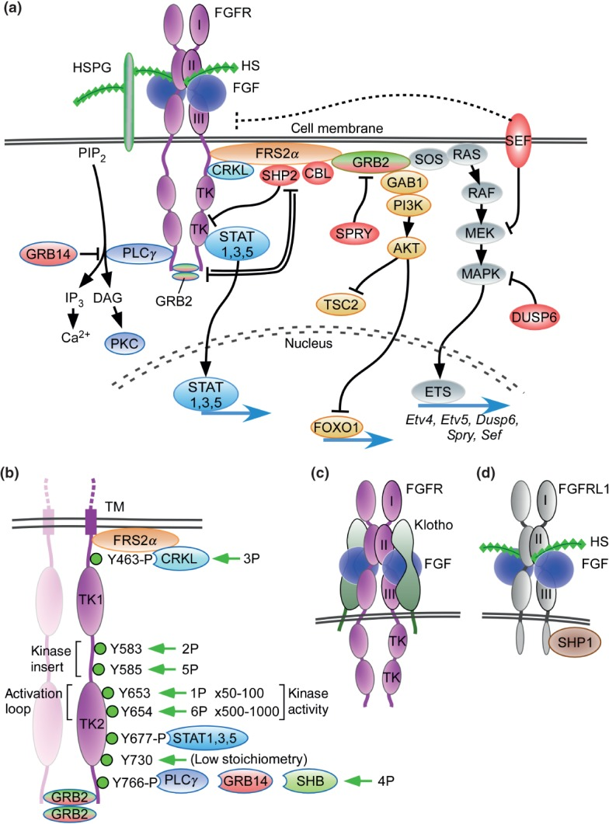
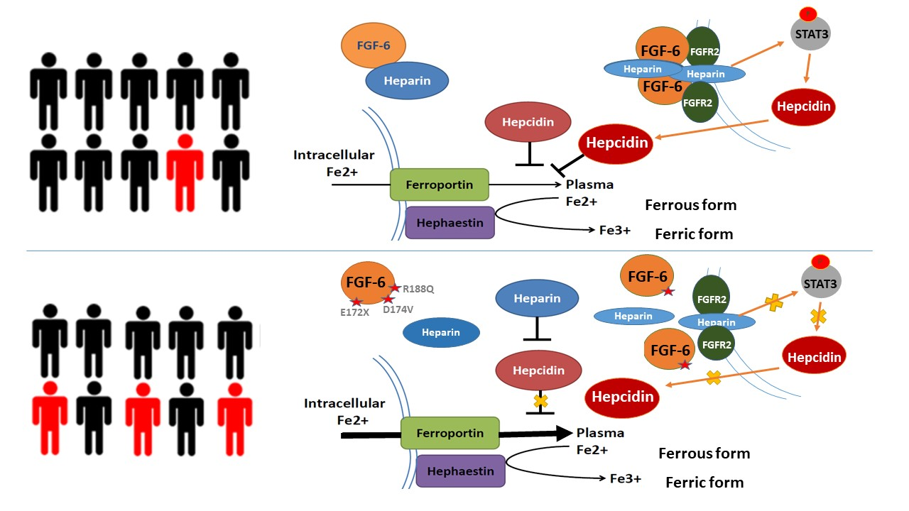
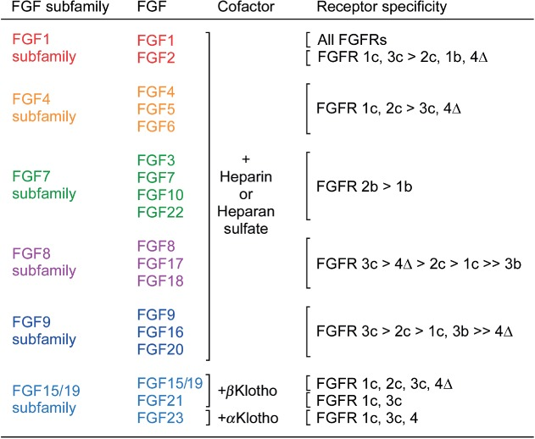
FGF6: gene family and pathway
Hepcidin (HAMP)
Heparin

Slide 20
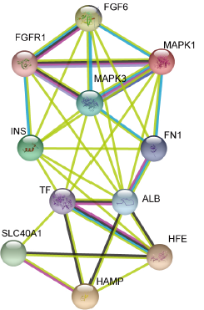
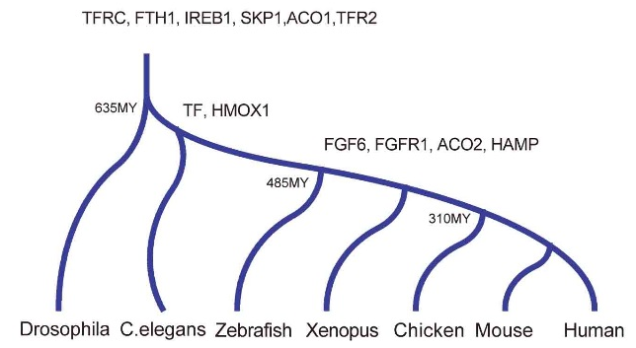
FGF6: molecular evolution and biological function
Encodes for the fibroblast growth factor 6 protein
Expressed across numerous tissues including skeletal muscle,
blood, liver and pancreas
Stage I: fundamental genes
Stage II: Regulatory Genes
Protein-protein interactions suggest
involvement of FGF-6 with Fe-metabolism
subnetwork

Slide 21
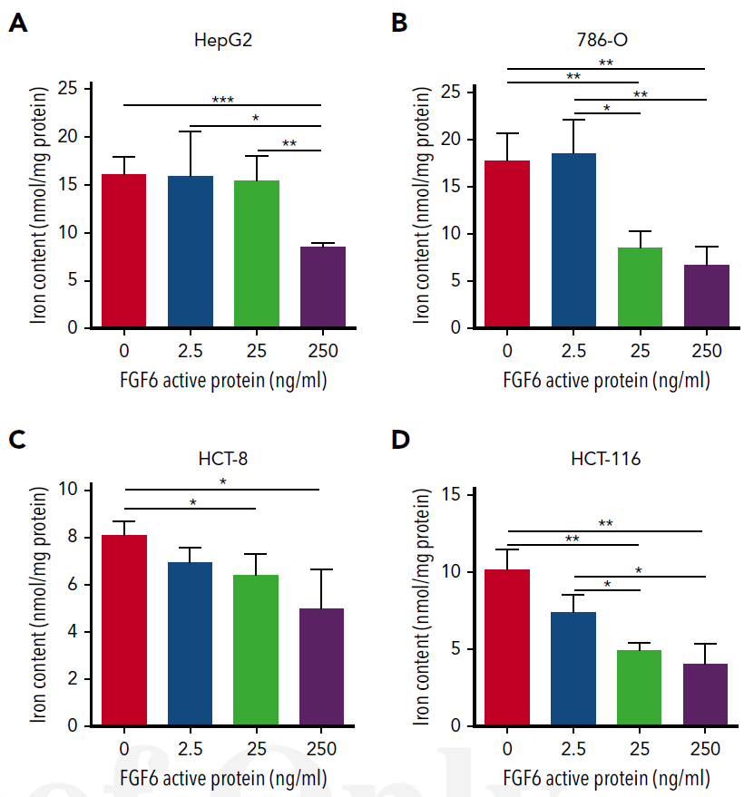
Dose-Dependent FGF-6 Impact on Intracellular Iron
FAC was added to culture media to induce iron overload cell model;
Ferrozine assay were conducted to measure total iron content.
FAC: Ferric Ammonium Citrate
Notes:
选择了肝脏（铁调控主要器官）、肠（铁吸收主要器官）。选用了HepG2 （肝细胞癌细胞）、HCT8和HCT116（结肠癌细胞）、786-O（肾癌细胞）等细胞中进行了分子生物学实验。通过FAC（柠檬酸铁胺）构建高铁细胞模型，发现外源FGF6活性蛋白处理可显著降低HepG2、HCT8、HCT116和786-O细胞中铁离子的含量（图2-1-9），且具剂量依赖性。检测铁离子含量的方法为菲啰嗪法。

Slide 22
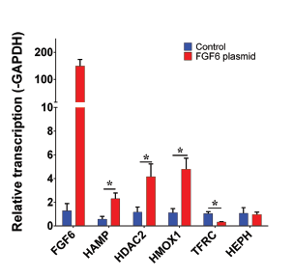
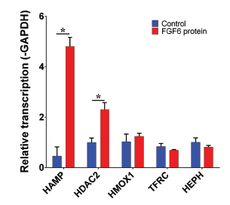
FGF-6 and FGF6 Transcriptional Regulation of Hepcidin (HAMP) in Hepatocytes
HAMP encodes for hepcidin
HDAC2 encodes for histone deacetylase 2
HMOX1 encodes for heme oxygenase 1
TFRC encodes for transferring receptor 1
HEPH encodes for hephaestin
Confirmed: FGF-6 could transcriptional regulate of Hepcidin (HAMP) in Hepatocytes
What is the biological Function of each variants?
Notes:
Real-time PCR 结果显示，在HepG2细胞中，FGF6的活性蛋白和过表达可显著上调铁代谢内稳态关键基因HAMP的表达，另外也可调控相关基因HAMP、HDAC2及HMOX1的表达.

Slide 23
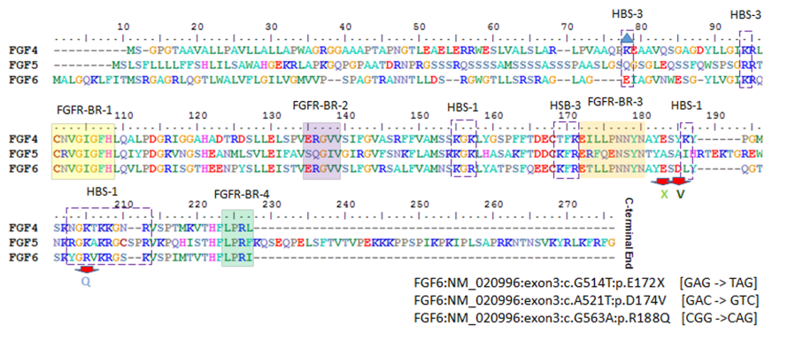
Evaluation of Three FGF6 Nonsynonymous Putative Functional Variants
Within or adjacent to heparin binding site motifs
Notes:
M1突变位点位于该基因的侧翼区，由谷氨酸变为终止密码子。M2突变位点位于该基因的侧翼区，由天冬氨酸变为缬氨酸。M3突变位点位于该基因的肝素结合区，由精氨酸变为谷氨酰胺。

Slide 24
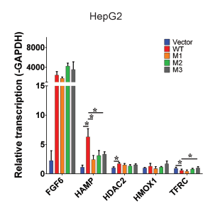
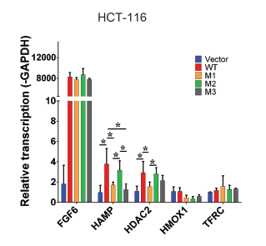
Variants Show Attenuation of Hepcidin Transcription Compared to Wildtype
M1: E172X
M2: D174V
M3: R188Q
Transfect FGF6 and variants into different cell lines
Notes:
通过检测FGF6过表达和点突变质粒过表达后对铁的吸收和上述铁代谢相关基因的变化，发现FGF6可显著提高HAMP的表达水平，而M1和M3突变后FGF6对HAMP的调控能力丧失。

Slide 25
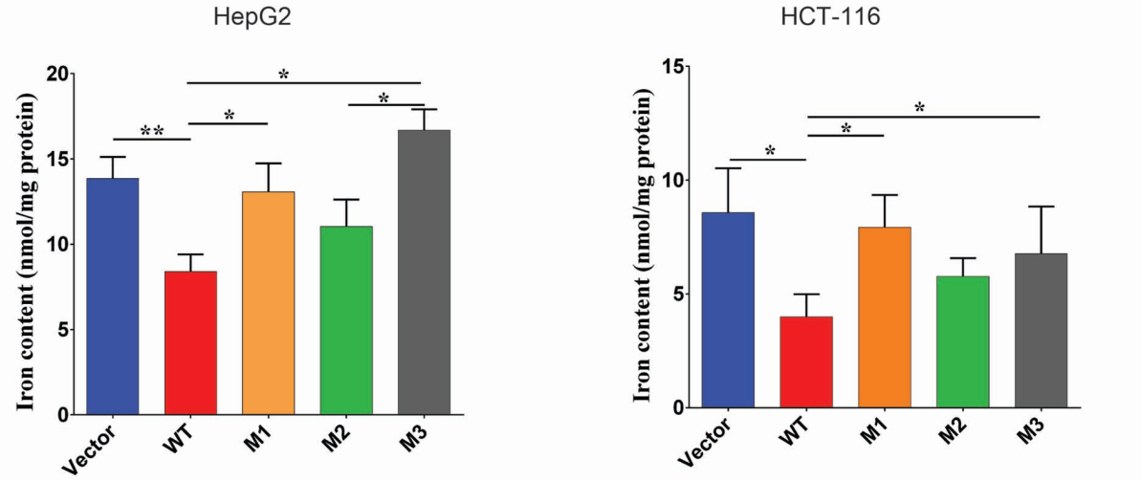
Variants Show increased Intracellular Iron Compared to Wildtype
M1: E172X
M2: D174V
M3: R188Q
Transfect FGF6 and variants into different cell lines
Notes:
通过检测FGF6过表达和点突变质粒过表达后对铁的吸收和上述铁代谢相关基因的变化，发现FGF6可显著提高HAMP的表达水平，而M1和M3突变后FGF6对HAMP的调控能力丧失。

Slide 26
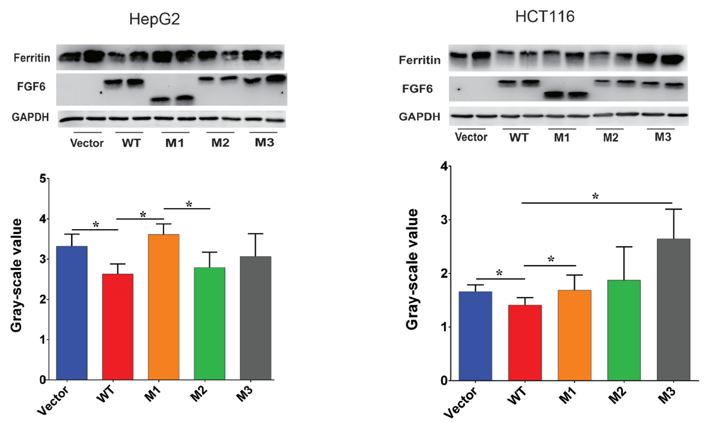
Variants Show Reduced Attenuation of Iron Uptake
Ferritin：surrogate marker to quantify iron.
Notes:
铁蛋白（Ferritin）是细胞内储存铁的蛋白。Fe²⁺会结合到铁蛋白上，储存在细胞内部。铁蛋白是由24个亚基组成，组合成有一个大的中心空腔的球壳，蛋白质外壳上的气孔可使铁的进出，一个铁蛋白可以结合≤4500个铁离子。因此铁蛋白的水平可间接反应铁离子的含量。通过Western Blot检测发现，在FAC的处理下，铁蛋白含量显著增多，而过表达野生型FGF6之后，铁蛋白含量显著下降，M1和M3过表达后，铁蛋白含量恢复到铁超载状态，M2过表达对野生型FGF6过表达相当。

Slide 27
Low FGF6 expression in liver cancer and systemic sclerosis
Control
HCC
Normal
SSc
Notes:
免疫组织化学检测肝细胞癌和硬皮病皮肤纤维化组织中FGF6的蛋白水平，利用平均荧光强度定量计算蛋白的表达水平。在肝细胞癌组织中，正常癌旁组织有明显的肝索结构，细胞大小规则，FGF6表达较高。但是在癌组织中，细胞大小不一，细胞排布杂乱，FGF6表达降低。
在硬皮病皮肤组织纤维化中，正常组织FGF6在100%的细胞中表达，表达量较高，但是在SSc中FGF6仅有部分表达，且表达量较低。

Slide 28
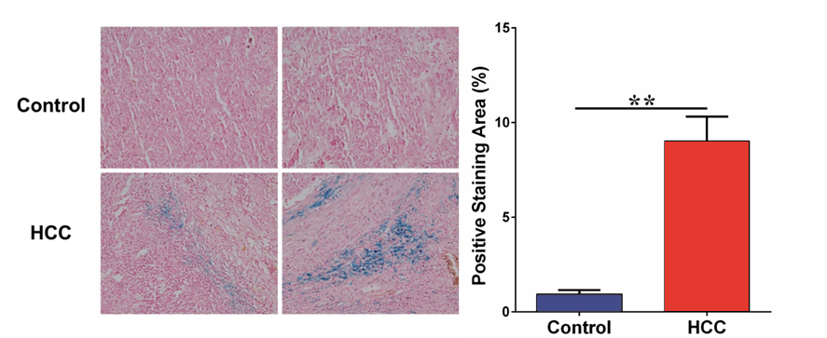
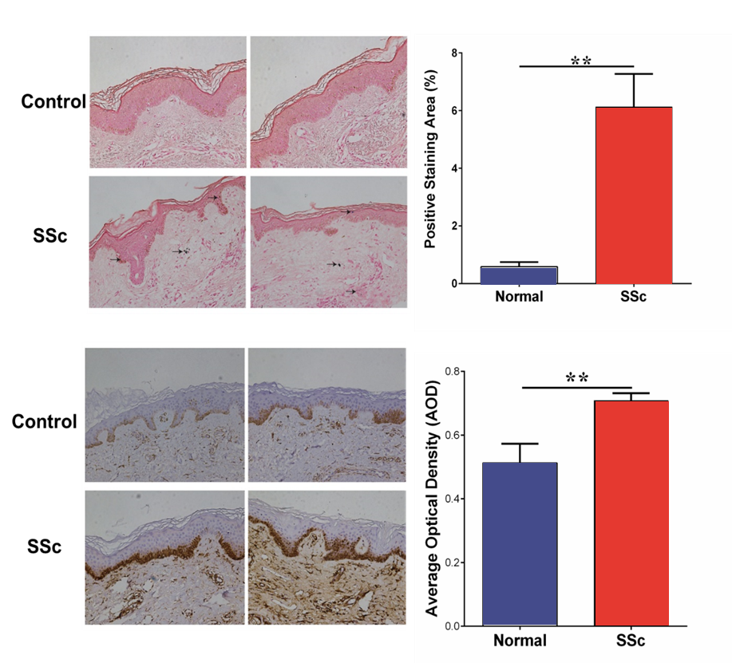
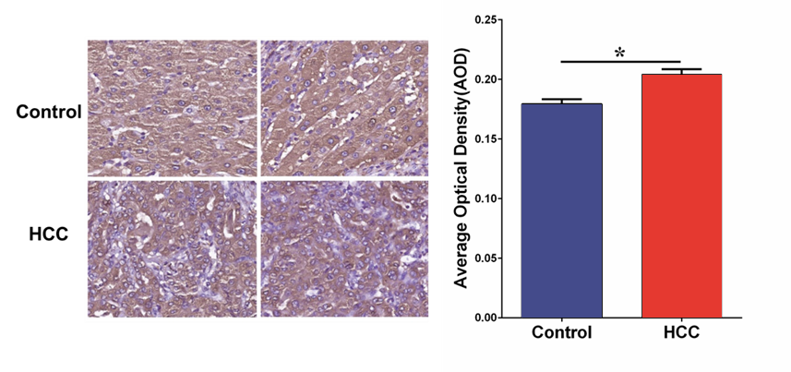
High iron deposition in liver cancer and systemic sclerosis
Per’s Stain was performed to detect iron, positive staining area to quantify iron accumulation;
Ferritin level was detected to quantify iron content.
Notes:
普鲁士蓝染色检测肝细胞癌和硬皮病患者皮肤组织中铁沉积水平，通过计算阳性区域的百分比进行定量计算铁沉积水平；免疫组织化学检测检测肝细胞癌和硬皮病患者皮肤组织中铁蛋白水平，利用平均荧光强度定量计算蛋白的表达水平。
在肝细胞癌组织和硬皮病皮肤纤维化组织中，有明显的蓝色铁离子沉积，但是正常组织中几乎没有铁离子沉积；
与正常组织相比，Ferritin的表达量较高，在硬皮病皮肤组织中，Ferritin主要表达于表皮的基底细胞层。

Slide 29
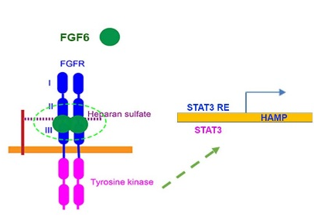
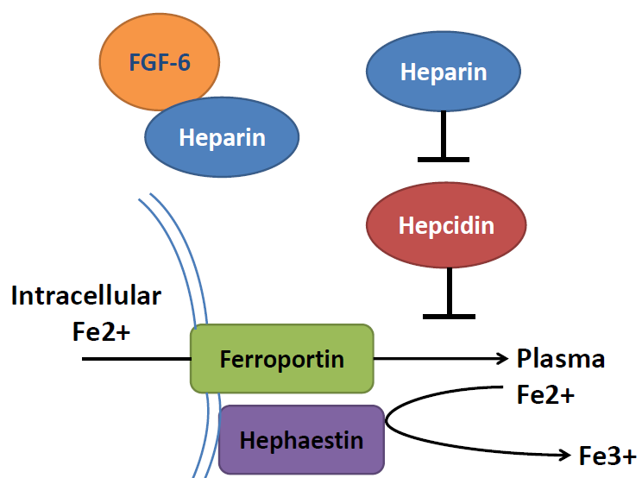
Marshfield Model: FGF6 decreases ferrous iron uptake in liver cells and induces increased hepcidin expression
Ferrous form
Ferric form

Slide 30
Marshfield Model: FGF6 decreases ferrous iron uptake in liver cells and induces increased hepcidin expression

Slide 31
Research contribution to clinical
 | Type 1 | Type 2A | Type 2B | Type 3 | Type 4
Name | Classic HHC | Juvenile HHC | Juvenile HHC | TfR2-related HHC | Ferroportin-related iron overload
Gene | HFE | HJV | HAMP | TfR2 | SLC40A1
Protein Produced | HFE | Hemojuvelin | Hepcidin | Transferrin receptor 2 | Ferroportin (iron regulatory protein)
Inheritance | autosomal recessive | autosomal recessive | autosomal recessive | autosomal recessive | autosomal dominant
Function | interruption of transferrin-bound iron, possible modulation of hepcidin regulation | unknown; possible hepcidin modulation | regulation of iron release in intestinal and blood cells | possible interference of iron uptake by liver cells | possible interference of iron export from intestinal, liver and placental cells
Organ Damage | variable | high | high | variable | low
Age of Onset | 40s or 50s | 20s or 30s | 20s or 30s | 40s or 50s | 40s or 50s
Type 5
FGF6-related iron overload
FGF6
Hepcidin and FGF6
CH recessive
?
?
?
1. Identified a new substype of hemochromatosis
2. More understanding to hemochromatosis
3, potiential drug targets for the therapy of hemochromatosis

Slide 32
Further study
Aberrant iron related gene expression in skin tissue of systemic sclerosis
Iron related gene expression in SSc skin samples: 153 SSc skin and 27 normal skin.
HMAP is significantly lower in SSc skin samples with P=9.47×10⁻⁶
Notes:
通过数据挖掘，从GEO数据库中整合了包括GSE76885、GSE95065、GSE94340以及GSE79387等数据集在内的多个SSc皮肤组织表达谱数据，并利用t检验，对其中铁代谢相关通路基因进行了差异表达分析。我们发现在硬皮病皮肤组织中FTH、FTL、SLC39A14、TFR2、CIAO1、HAMP、BMP6等发生了显著的降低。

Slide 33
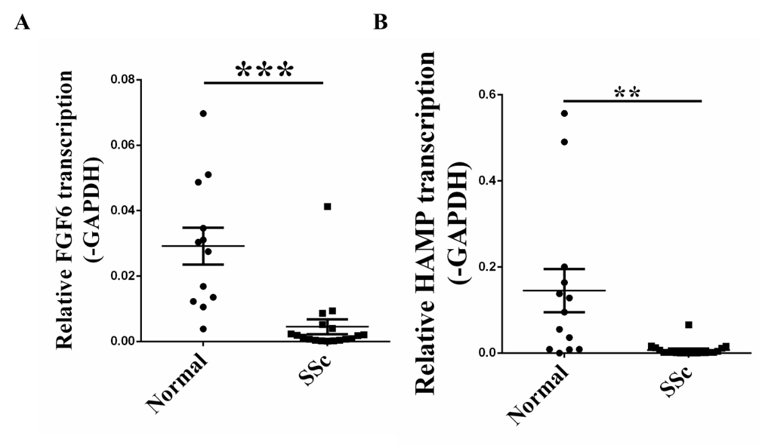
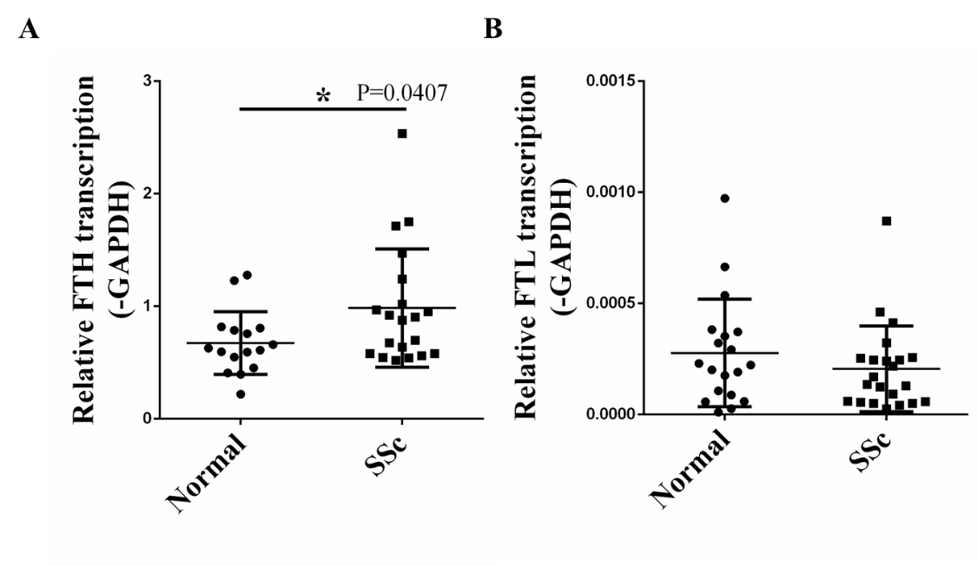
Further study
Aberrant FGF6 and iron related gene expression
in skin tissue of systemic sclerosis
Gene expression were validated in skin tissues:
22 SSc and 24 Control;
mRNA level of FGF6 lowered 6.4 times;
Iron related genes such as HMAP is significantly lower in SSc skin samples, while FTH is higher in SSc skin samples.
Notes:
FGF6的mRNA水平下降了6.4倍（0.02916 ± 0.005645 vs 0.004517 ± 0.002256 N=18）（图5B）。上述结果进一步证实了硬皮病皮肤纤维化中存在FGF6表达降低及铁代谢紊乱的现象。

Slide 34
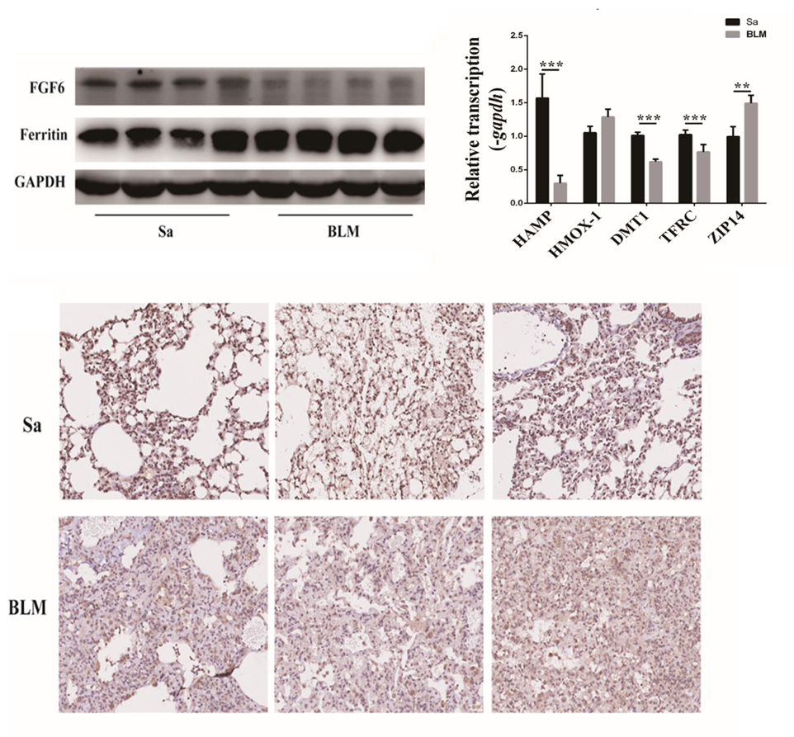
Further study
Aberrant FGF6 and iron related gene expression
in BLM induced mouse lung fibrosis
A
C
(A) FGF6 was significantly decreased in BLM induced lung fibrosis by Western blot;
(B) Loss of FGF6 protein expression in many cells according to IHC;
(C) Aberrant iron related gene expression in lung fibrosis.
B
BLM：Bleomycin
Notes:
BLM诱导的小鼠肺纤维化组织中，Western blot 和IHC 表明FGF6蛋白表达显著降低，IHC表明FGF6的表达降低是部分细胞表达丢失导致的。

Slide 35
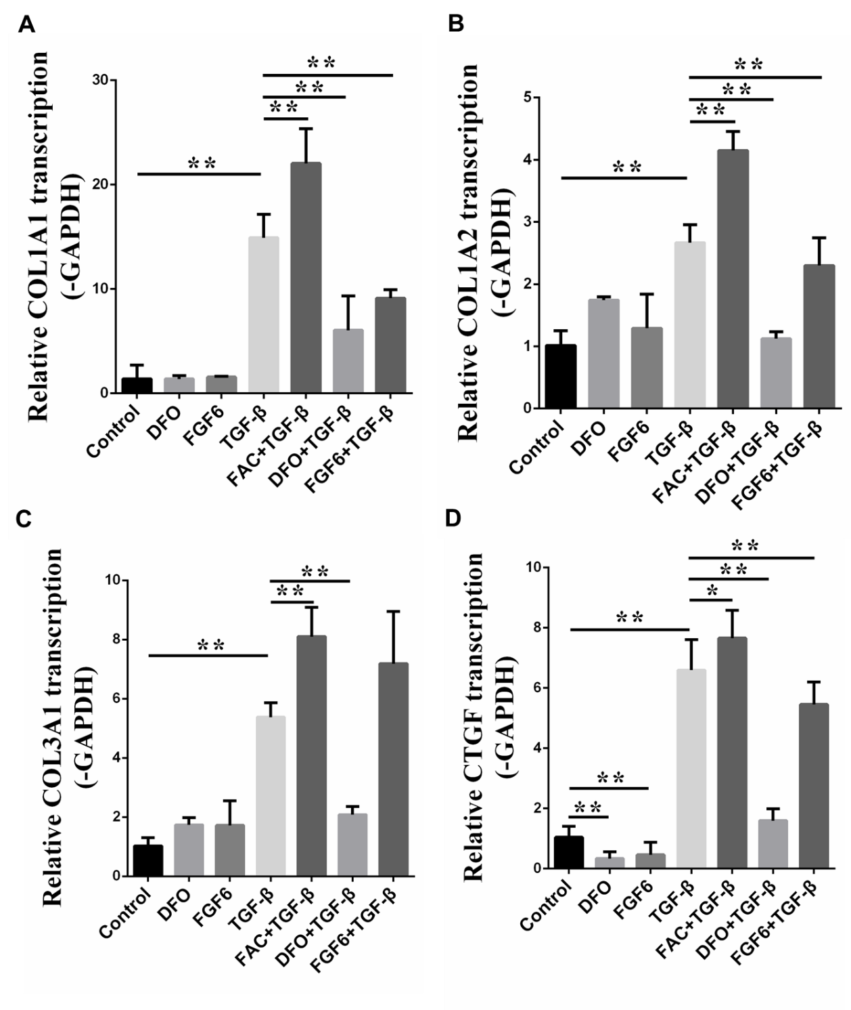
Further study
FGF6 and DFO attenuated TGF-β induced gene expression
TGF-β can significantly promote the expression of fibrotic genes such as COL1A1, COL1A2;
FAC can promote the expression of fibrotic genens;
FGF6 active protein and DFO reduced fibrotic response.
DFO：Deferoxamine
Notes:
培养原代皮肤成纤维细胞，利用TGF-β诱导构建纤维化细胞模型，并在此基础上探索铁对纤维化细胞模型的作用。定量PCR结果表明去铁铵（Deferoxamine，DFO）和FGF6活性蛋白可直接降低CTGF和TGF-β的表达（图2-3-3D，图2-3-3G），FAC可上调COL1A1、COL1A2、COL3A1、CTGF、α-SMA、FN1和TGF-β等纤维化相关基因的表达，而FGF6蛋白和DFO可显著缓解胶原的表达（图2-3-3A-G）。上述结果表明，铁的累积可以显著加重TGF-β诱导的纤维化反应，而螯合铁离子和给与FGF6活性蛋白可显著抑制FGF6诱导的纤维化反应，因此铁代谢在纤维化过程中具重要作用。

Slide 36




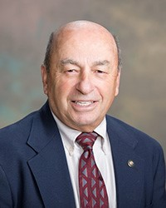


Acknowledgements
Brent Olson, MRCI
Terrie Kitchner, MCRI
Jeffrey Joyce, MCRI
Robert Strenn, MCRI
Joseph J. Mazza Steven Schrodi Jennifer K. Meece

Slide 37
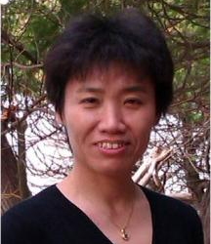



Acknowledgements
Prof. Jiucun Wang
Fudan University
Dr. Shuai Jiang
Fudan University
Dr. Naren Epperla
OSU
Assoc Prof. Judy Smith
UW-Madison

Slide 38
